Slide 1




How to get Certified in AWS
Certification guide

Slide 2

What is Cloud Computing?
Cloud computing is the on-demand delivery of compute, database storage, applications, and other IT resources
though a cloud service platform via the internet with pay as-you-go pricing.
Think of it as simply renting someone else's computer!
Advantages of Cloud
Pay only for what you use
Stop guessing about capacity
Cloud can scale with your business needs, with no long-term contracts
Stop spending money running and maintaining data centers
Go global in minutes
Types of Cloud Computing Deployments
Public Cloud – AWS, Azure, GCP
Hybrid – Mixture of public and private
Private Cloud (Or on Promise) – You manage it,
in your datacenter. OpenStack or Vmware

Slide 3
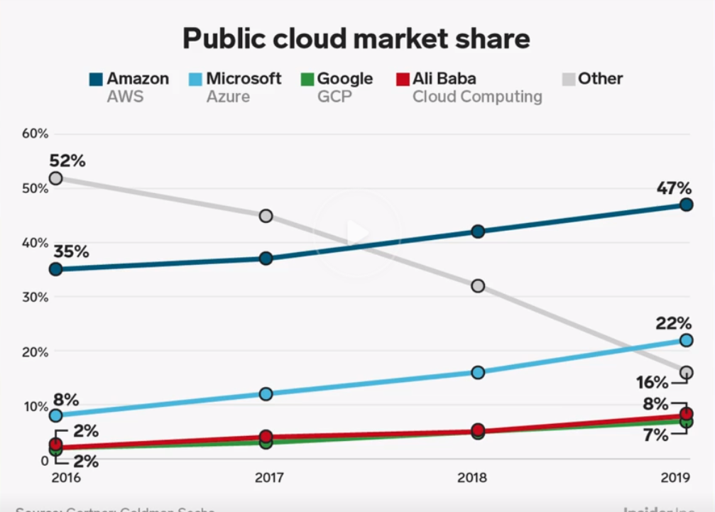

Slide 4
AWS Certifications List
Amazon Web Services credentials fall into 2 main categories:
Core Certifications and Specialty Certifications.
AWS core certifications span three knowledge areas: architecture, development, and operations, and are offered in 3 skill levels: foundational, associate, and professional.
AWS specialty certifications validate advanced expertise in targeted IT disciplines, such as information security, big data, and networking.
Let's break down these categories and the certifications available in each:

Slide 5
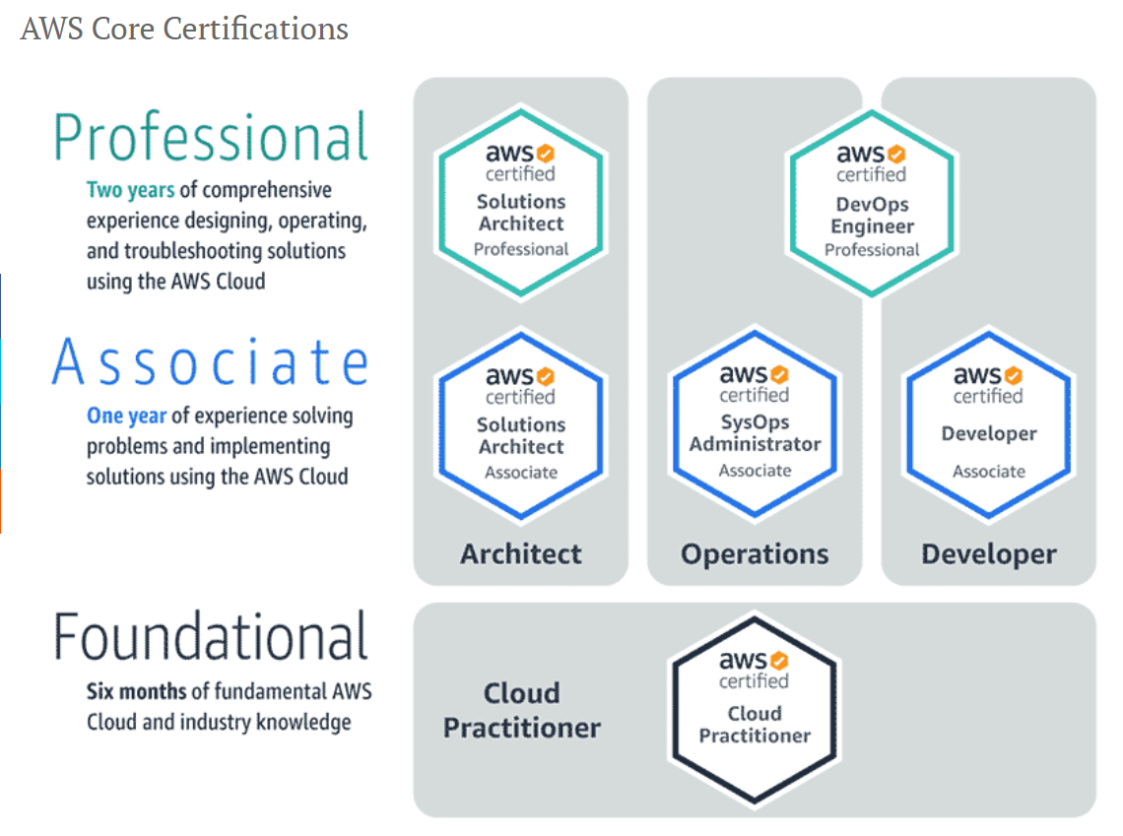

Slide 6
Which cloud certification is best?
Foundational Certification: AWS Certified Cloud Practitioner
Understanding of basic AWS architectural principles/concepts
Key AWS services and their common use cases
Basic security and compliance, the shared responsibility model for security
Associate-Level Certifications: AWS Certified Solutions Architect
Network technologies and how they work in AWS
The exam domains include the design of highly available and scalable systems, (requires familiarity with AWS
infrastructure and concepts), implementation and deployment in AWS, AWS-related data security practices, disaster
recovery techniques, and troubleshooting
AWS Certified Developer
Understanding the basic AWS architecture and the core AWS services
Hands-on experience designing, developing, deploying, and maintaining applications
Working knowledge of applications that utilize key AWS services such as AWS databases, notifications, workflow
services, and services for storage and change management services
AWS Certified SysOps Administrator
Sending and receiving data between data centers and AWS
Selecting the appropriate AWS services to meet an organization’s needs
Provisioning, managing, and securing systems in an AWS environment

Slide 7
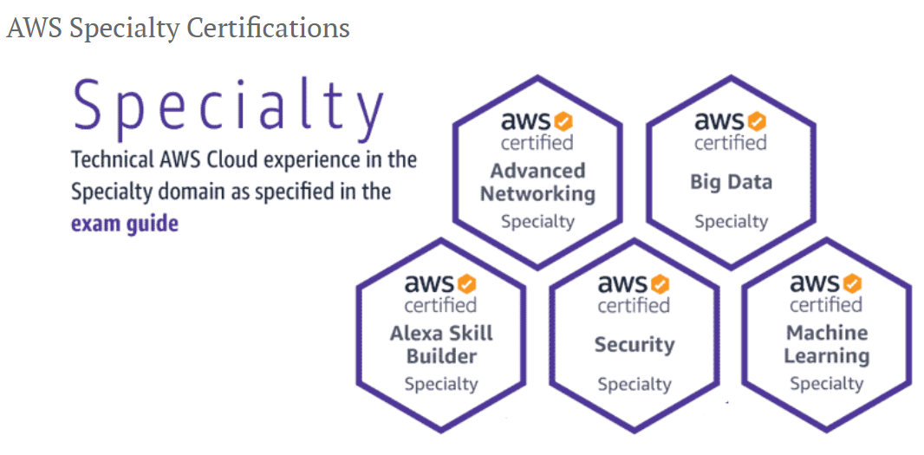

Slide 8
AWS Certification Exam Cheat Sheet
Online blogs
Jayendra’s Blog: http://jayendrapatil.com/
A Cloud Guru discussion forums: https://acloud.guru/forums/rooms?p=1
Our best friend Google
Online courses
A Cloud Guru platform: https://acloud.guru/
Udemy: https://www.udemy.com/
Linux Academy: https://linuxacademy.com/
Practice exams
AWS practice exam
A Cloud Guru platform (exam simulator)
Whizlabs (Around 500 questions)
Braincert
AWS FAQs for each service

Slide 9
Question/Answers
How much does an AWS certification exam cost?
Cloud Practitioner exam is 100$
Associate level certifications are 150$
Professional and Specialty certifications are 300$
Are there benefits offered to AWS Certified individuals?
Yes, AWS Certification gives you tangible benefits to help you showcase your achievement and further advance your AWS expertise.
Where can I access my benefits?
Gain access to exclusive AWS Certified benefits via aws.training. Once signed in, go to your AWS Certification Account where you’ll have access to all your benefits. Benefits will be available within five business days after passing your exam.
What happens if I fail AWS certification?
Test takers who do not pass an exam must wait 14 days before they are eligible to retake the exam. There is no limit on exam attempts until the test taker has passed. For each exam attempt, the full registration price must be paid. Beta exam test takers are eligible for one attempt only.

Slide 10
AWS Certification Salaries
In the short time since the Amazon Web Services certification program launched in 2013, AWS certified pros already rank among the highest paid IT certification holders. According to a recent salary survey from Global Knowledge, the average wage for AWS certified individuals is $123,932.
Here is a breakdown of average salary by AWS certificate (U.S. and Canada only):
AWS Certified Solutions Architect – Associate: $127,773
AWS Certified Solutions Architect – Professional: $146,259
AWS Certified Developer – Associate: $122,984
AWS Certified DevOps Engineer – Professional: $139,743
AWS Certified SysOps Administrator – Associate: $135,149

Slide 11

Now, it’s time to schedule an exam, please use following link to schedule it
https://aws.amazon.com/certification/

Slide 12
We can get connected through LinkedIn or Instagram
LinkedIn: Adilet Kaziev
Instagram: kazi_kg

